Slide 1
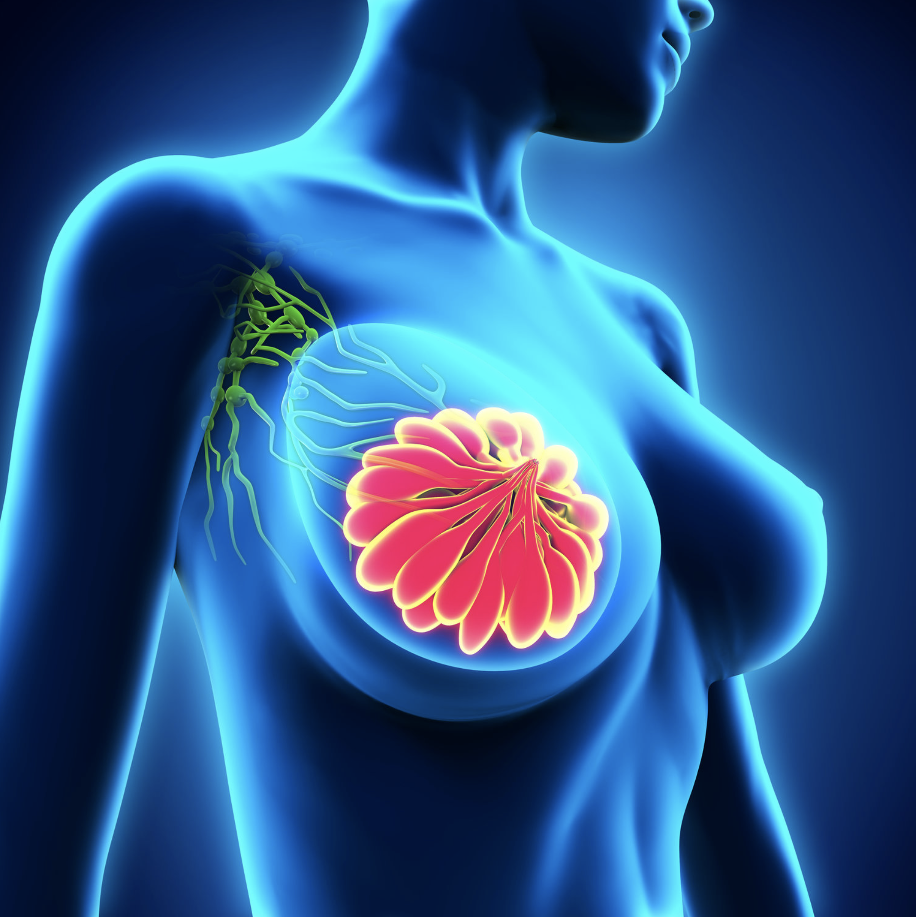
Advanced Machine Learning
Prof. Fabio Galasso
AY 2019/2020
Diletta Abbonato
Francesco Pezone
Lucia Testa
| 1672915
| 1913202
| 1764018

Slide 2

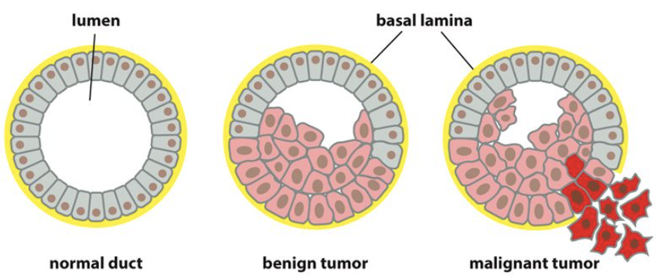
Project Scope
1
2
Classify breast images according to ACR density index
Classify breast images according to their diagnosys of being Malignant, Benign or Normal

Slide 3
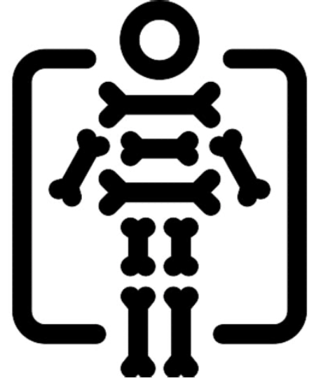

Dataset
Polyclinic Umberto I data which is composed by 214 cases. The Digital Mammography images in dataset are of both breasts in the mediolateral oblique (MLO) and craniocaudal (CC) position.
We used 200 cases of train and validation with use the rule of 85 -15 division and the remaining for the test.
Breast Tomosynthesis Detection
Screen Mammograms
We have divided the cases into different folders, creating 3 signs for benign, normal and malignant cases.
We repeat the same step to divide our 214 cases in the four ACR ( Breast
density index) in order to classify the same images for their density.

Slide 4
Support Data
Since the quantity of mammograms is very low we used the DDSM dataset as support. The DDSM is a database of 2,620 scanned film mammography studies. It contains benign and malignant cases with verified pathology information.
To obtain the data we used the NBIA Data Retriever software. The data was in DICOM format that we converted to jpg. We divided the data into 1548 for the train and validation using the 85-15 rule while 1328 for the test.

Slide 5

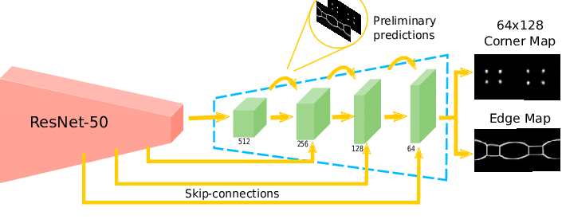
Model Used
We tried initially to train the net from scratch, but we got bad results.
We have used the VGG16 and ResNet50, ensuring from literature that their behavior for breast cancer classification was excellent as a support for our data.VGG was born out of the need to reduce the number of parameters in the CONV layers and improve on training time.
ResNet addresses his network by introducing two types of ‘shortcut connections’: Identity shortcut and Projection shortcut. ResNet architecture makes use of shortcut connections do solve the vanishing gradient problem. The basic building block of ResNet is a Residual block that is repeated throughout the network.

Slide 6
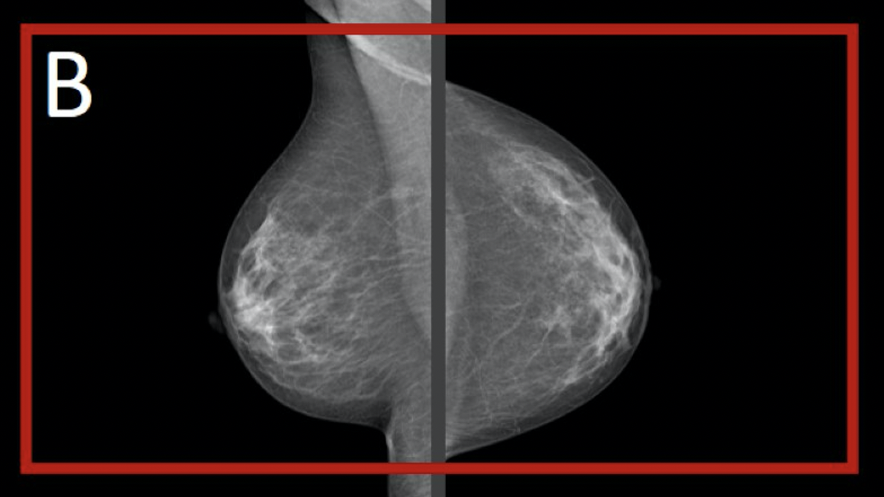
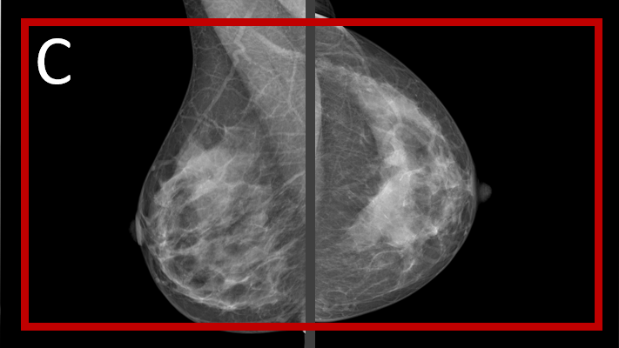
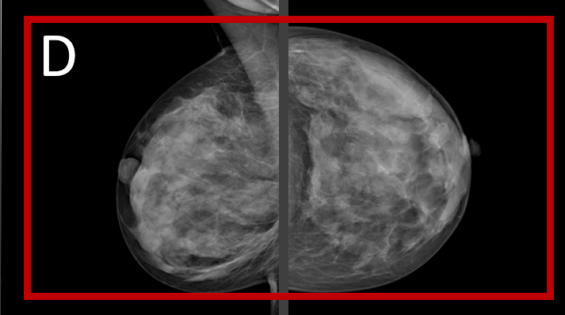
Density assesment
Density Assessment
Density
Goal
Classes
Quantity of fibrograndular tissue.
Classify breast mammograms for ACR indeces.
We dropped the A because we had just one case. For the rest we have 38% of both B and C, and 23% of D.

Slide 7
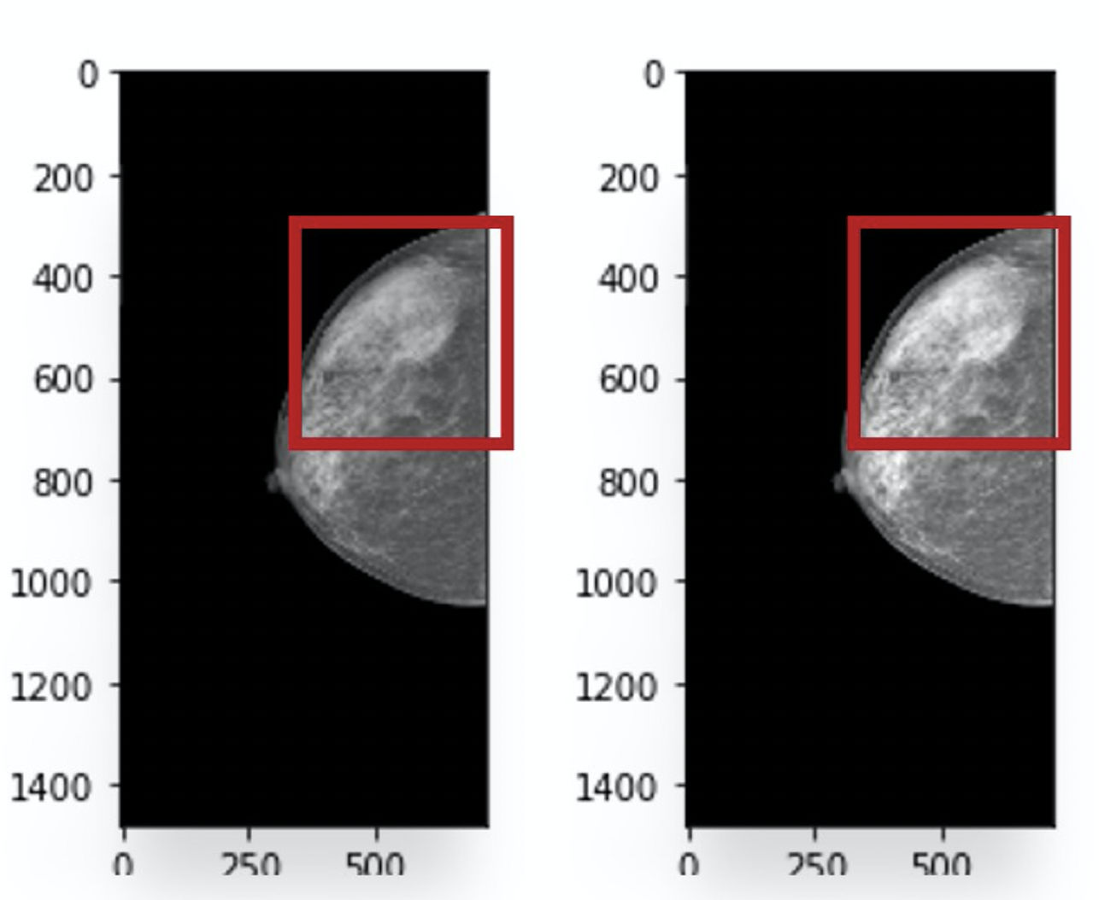
Density assesment
The Importance of Data Augmentation
During our first attempt we didn’t use any color corrections on the images.
Even if the results were quite good, we tried to improve the analysis by applying ColorJitter transformations, changing the contrast we improved our results reaching 75% on test.

Slide 8
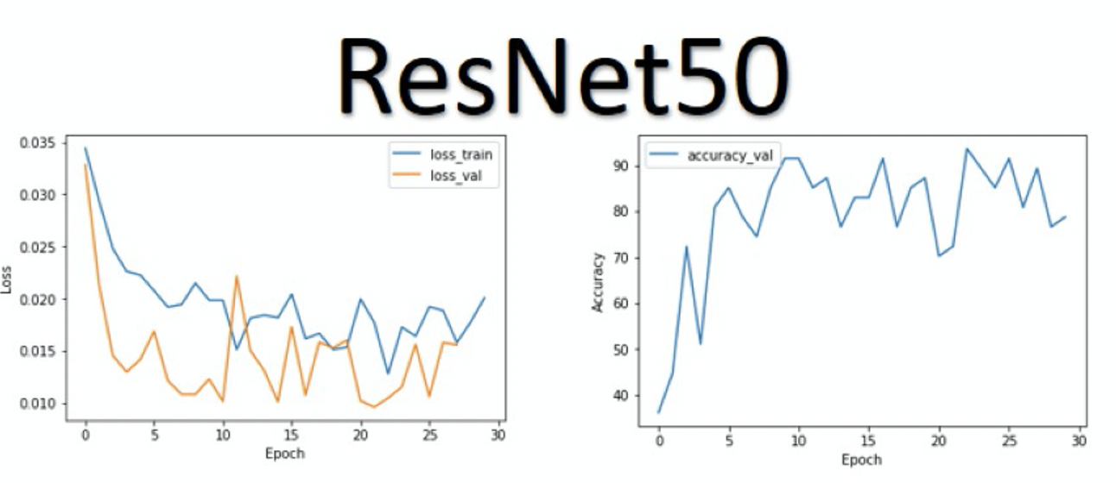
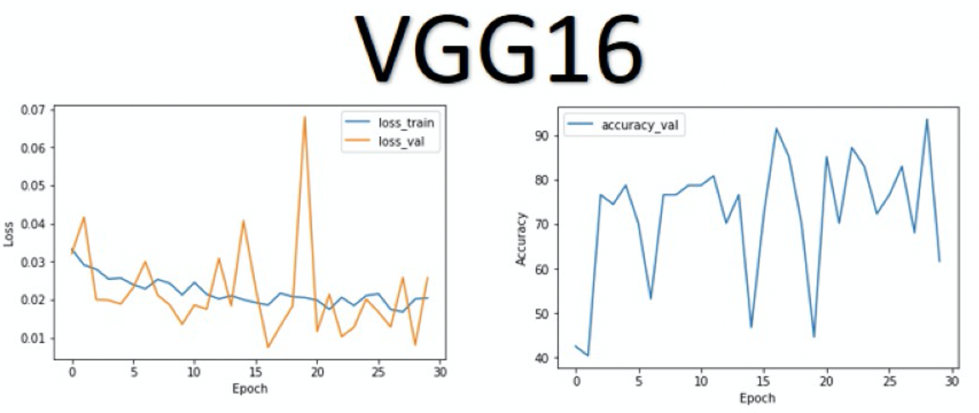
Results
Results
ResNet50 showed a better performance than VGG-16 under the same data augmentation conditions.
Even reaching a validation accuracy of 90%, the VGG reached a 66% of accuracy in test.
ResNet50, instead, reached a 75% in test

Slide 9
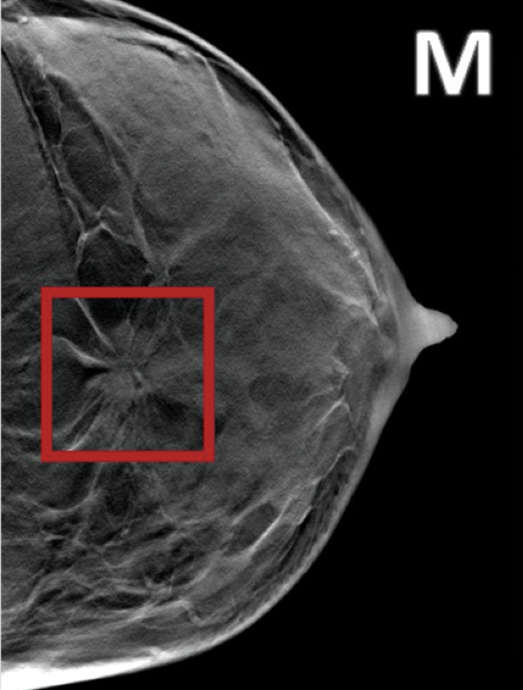
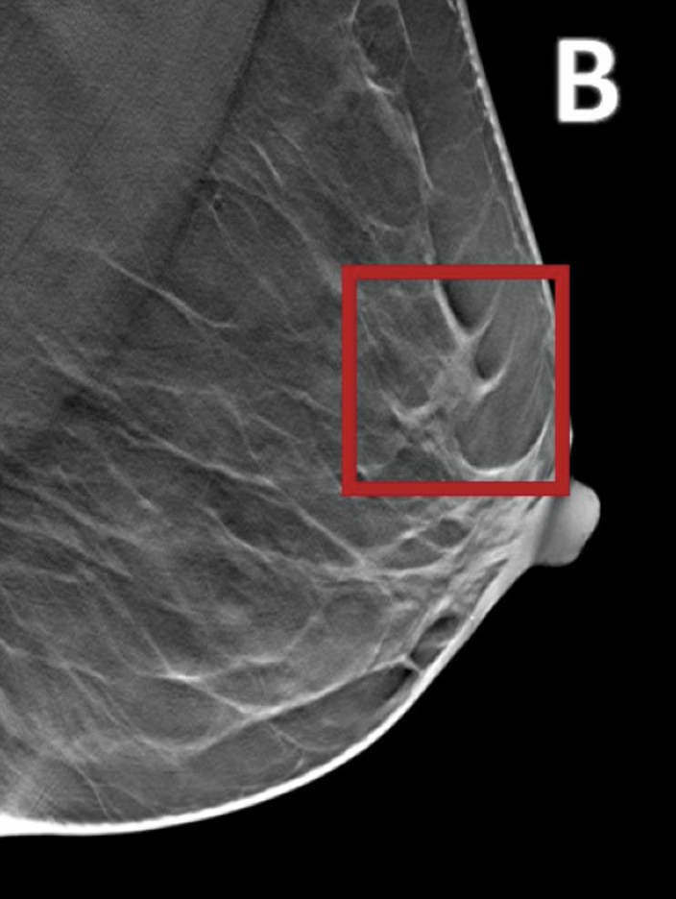
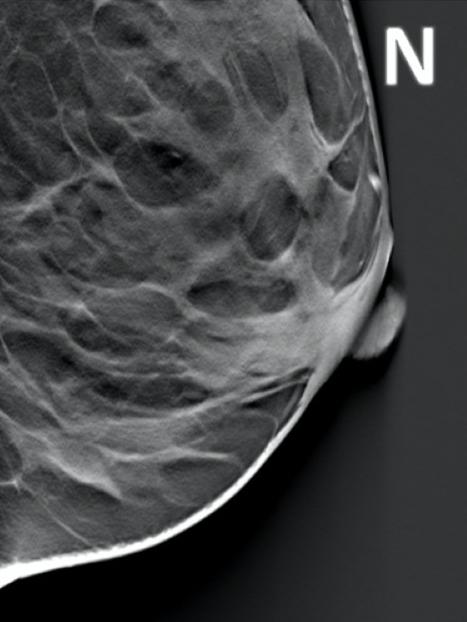
Results
Breast Cancer Diagnosis using Digital Tomosynthesis

Slide 10
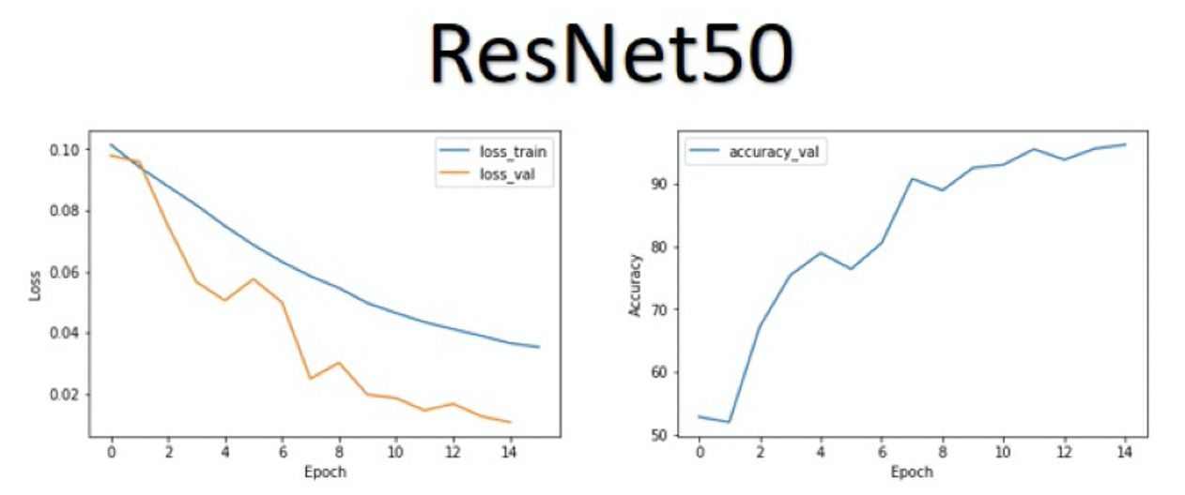
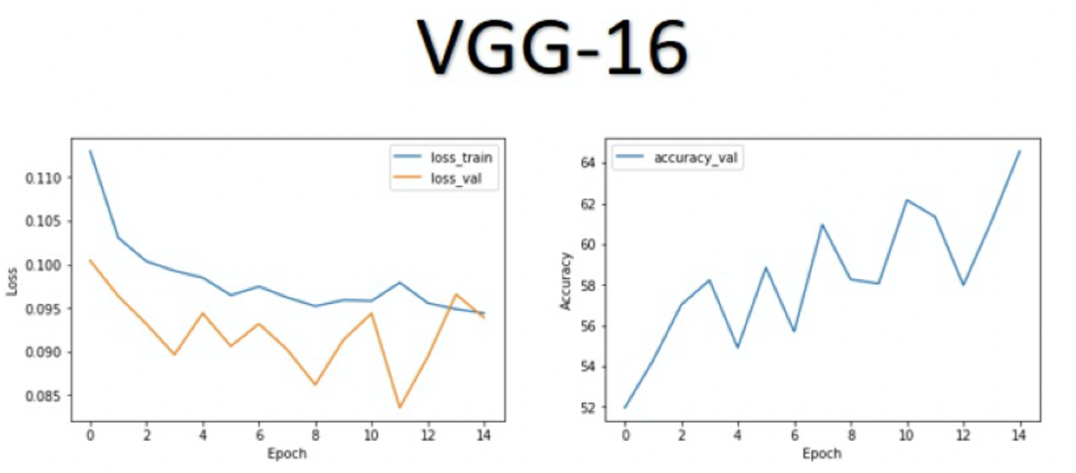
Results
Results
We can see that ResNet50 performed better than VGG-16, reaching a validation accuracy of 90%.
BUT, the 65% cannot be considered as a bad result.
During the test it recognizes most of the malignant cases. So we have to attribute the low accuracy to the difficulty of distinguishing Normal and Benign.
Still, we can say that even with the VGG16 we partially achieved our goal, since the important thing for this type of analysis is to identify the malignant mass.

Slide 11
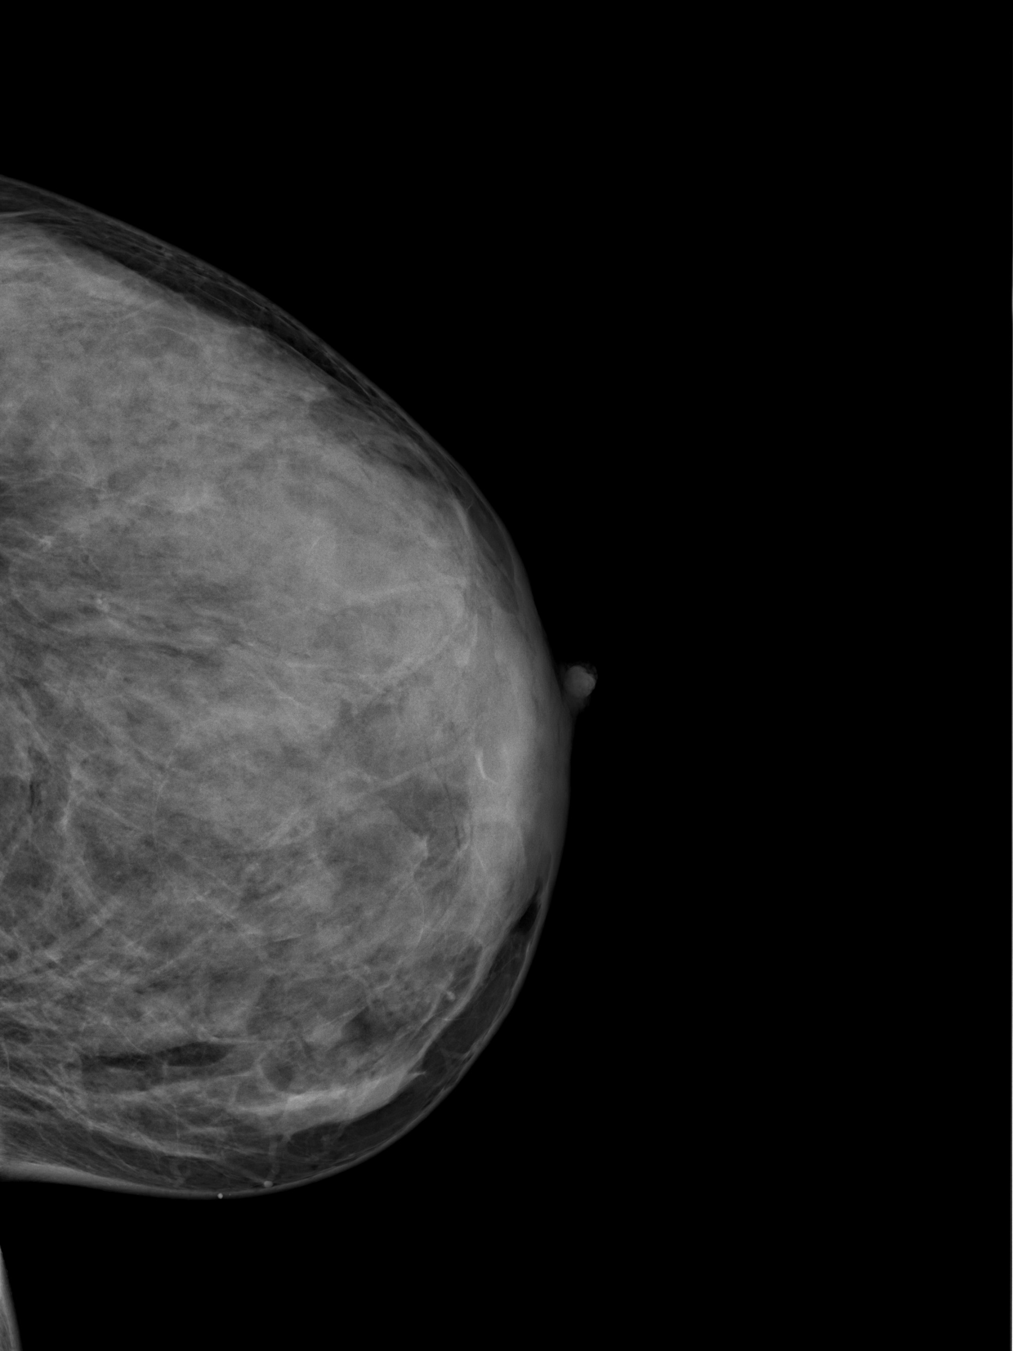
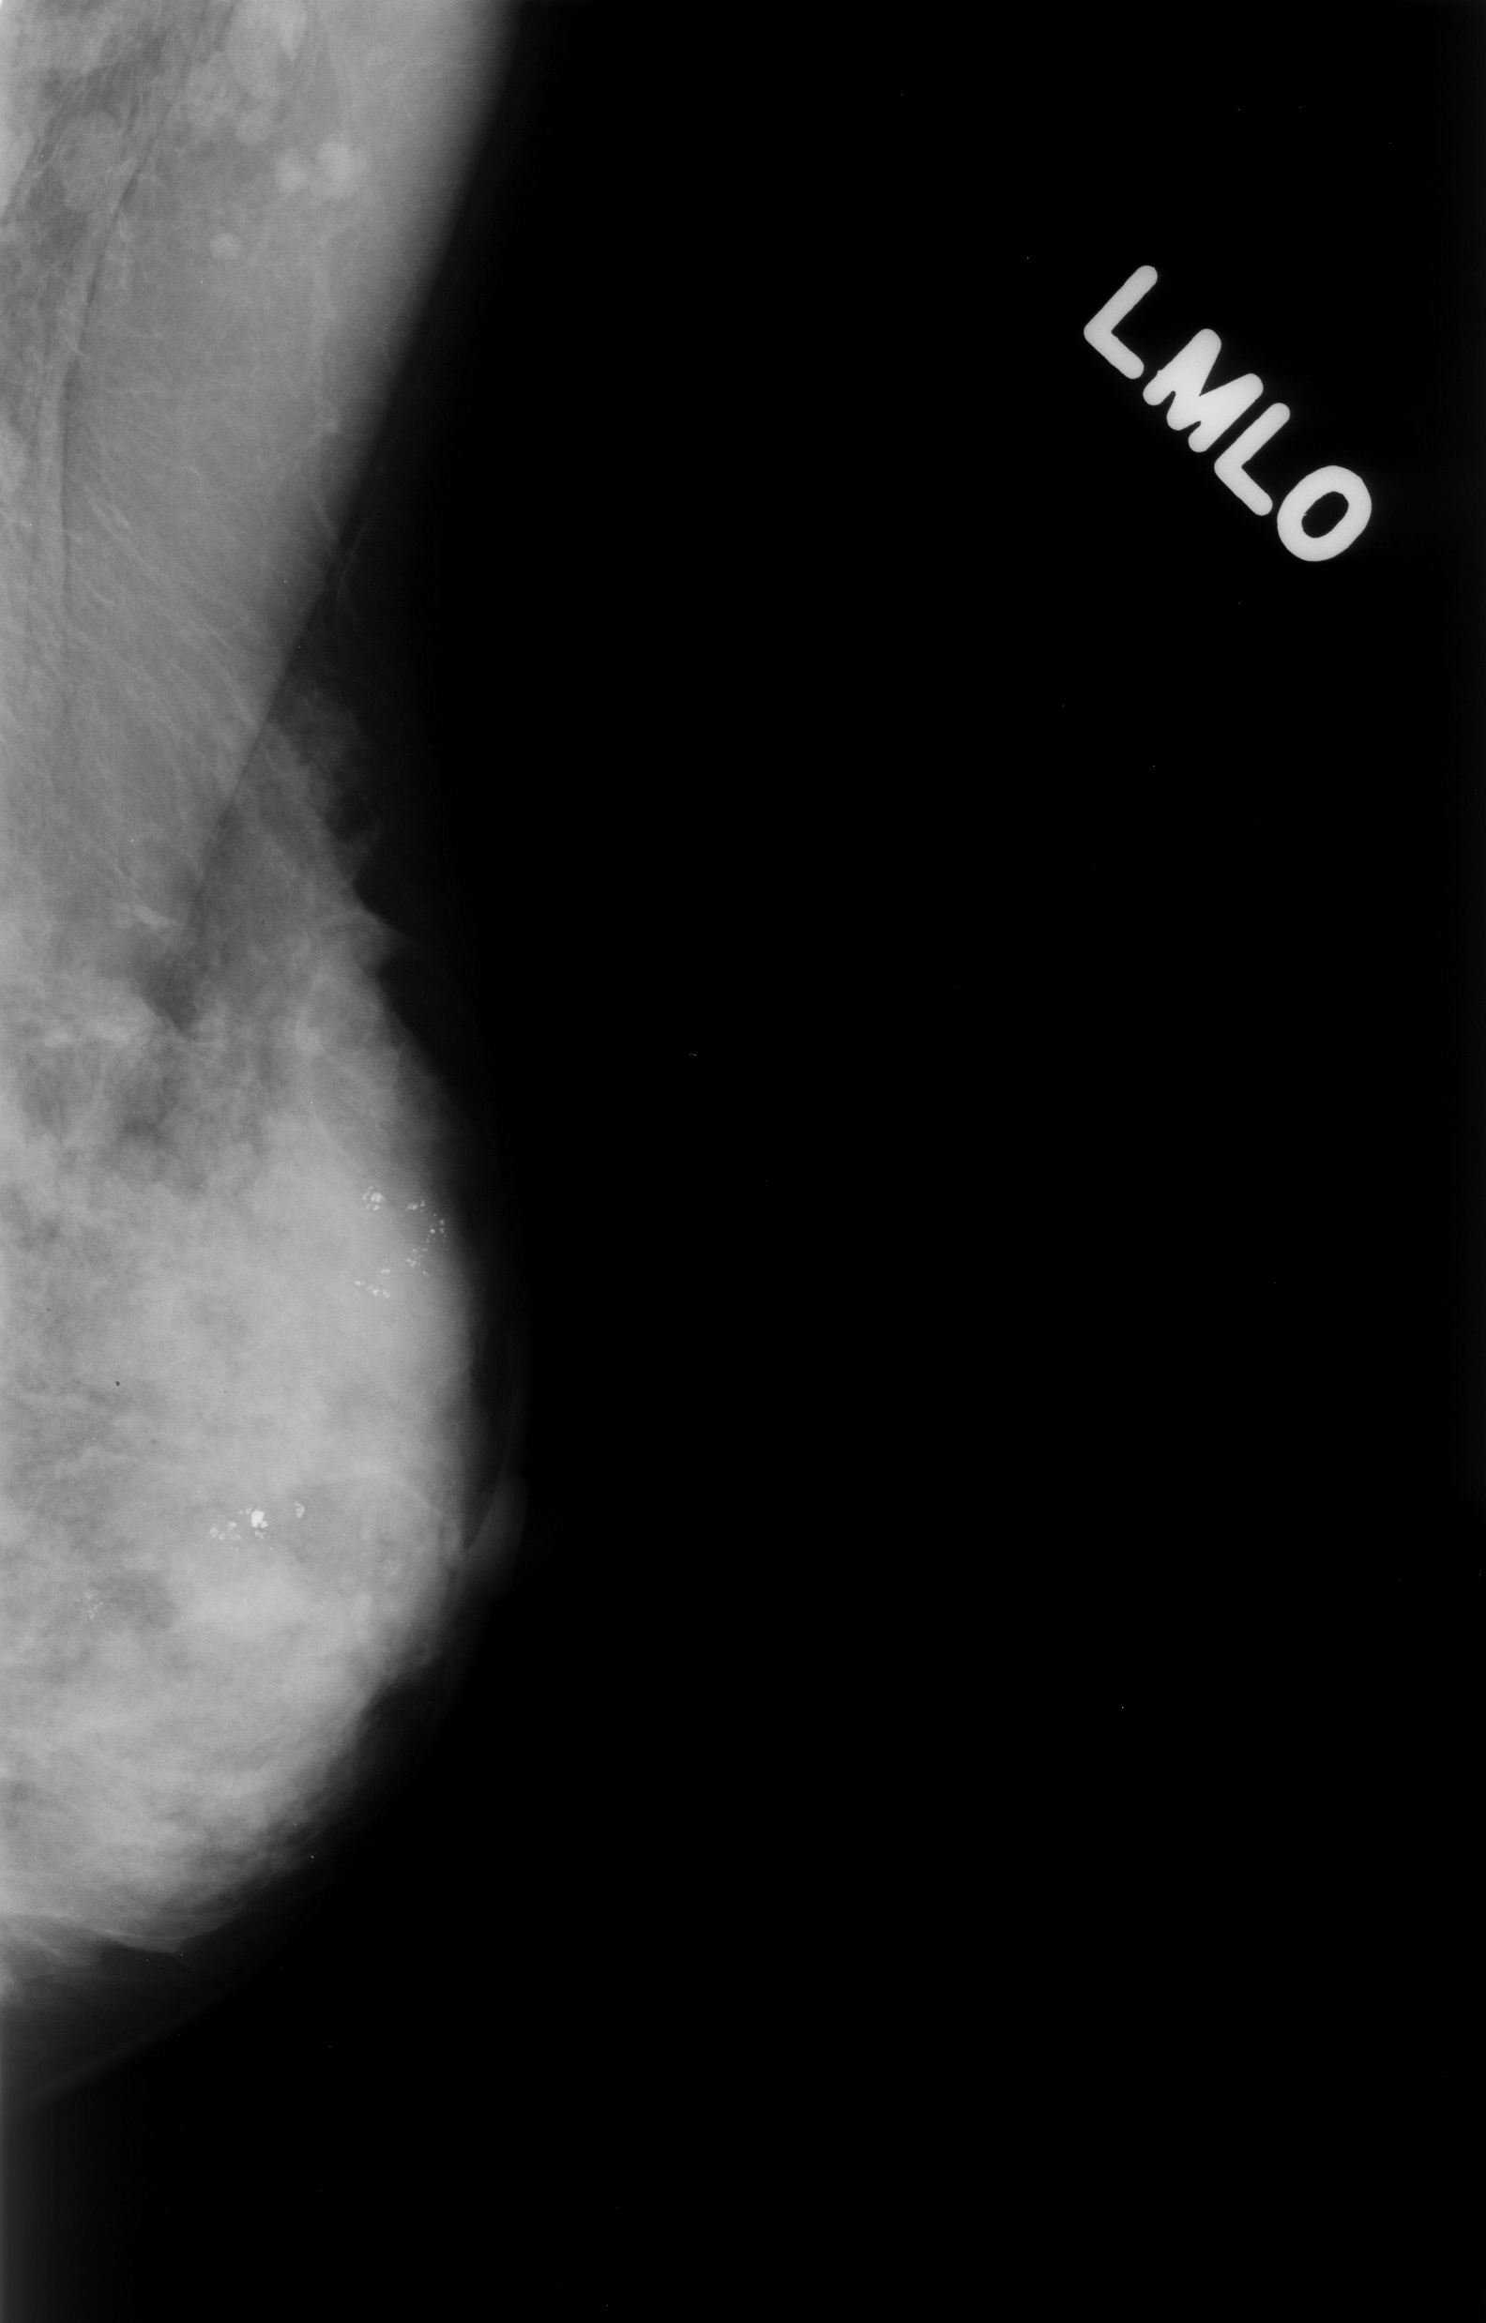
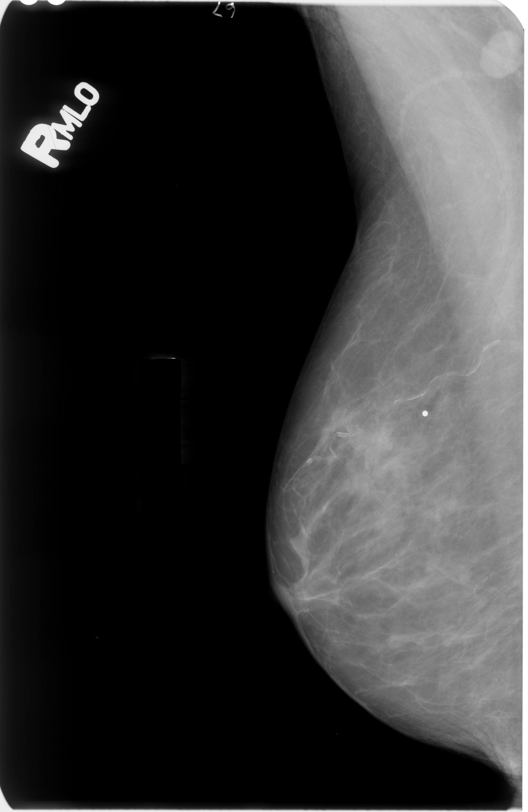
Results
Mammograpy
Our Dataset
Stanford Dataset
Idea!
Pre-train on the Stanford dataset and after on our dataset

Slide 12
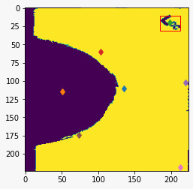
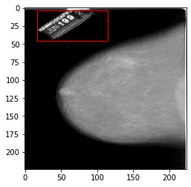
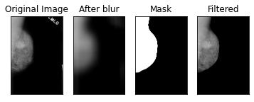
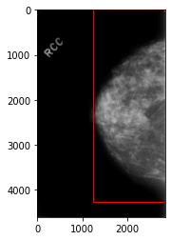
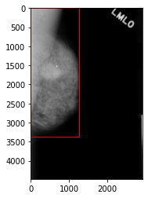
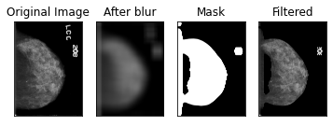
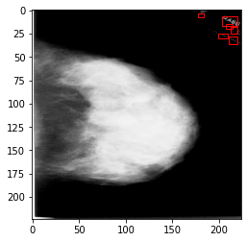
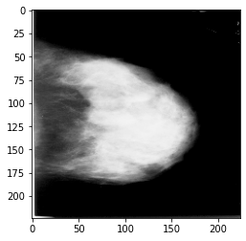
Three Different Approaches
Filtering the Image
Connected Components
Text Detection

Slide 13
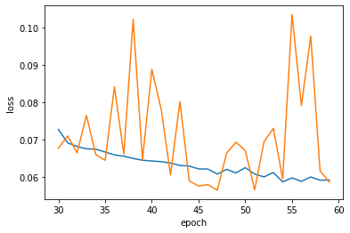
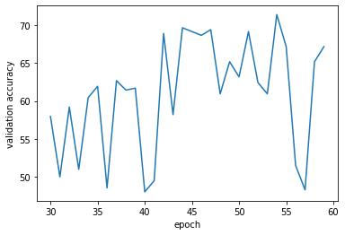
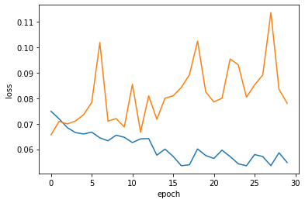
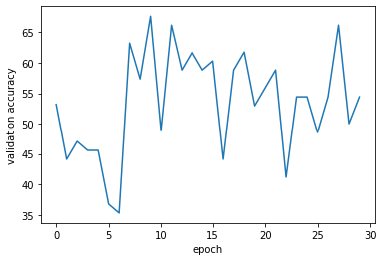
Results
Even trying to apply all the different ways we showed before to modify our breast images of DDSM, the network showed the worst behaviour encountered.
There’s not apparence of a true learning in the plots, but just a random chance to guess the right class.
Even if the Mammography is the most common type of exam that we know is also the most difficult to understand.
The main problem during the training of DDSM in not only the text on the images but also the quality of mammogram itself, that does not allow a good detection of mass.
ResNet + Stanford
ResNet & Stanford + Ours

Slide 14
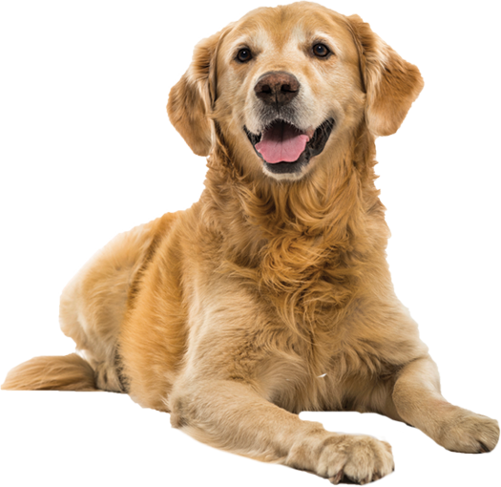
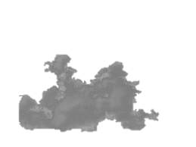
Conclusion
The main problem for our cancer detection analisys is that a mass in the breast
is a ‘bigger’ opacity intra opacities, so the detection could be problematic when there is to much noise.
Even if the network itself could be considered as reacting well to the noise here we can say that the quality of images itself hindered to much the learning process
Beyond this you may ask why the transfer from DDSM to Policlinico went so bad. Our breast images come from a study for demostrating how much the DBT helps in finding out masses when the density of breast is to high. So since our first learning process from ImageNet to DDSM didn’t produce good results, it has been quite impossible to transfer very noised images to a bad model.

Slide 15
THANK YOU!
QUESTIONS?

